Slide 1
2019 Council for Leadership Development Leadership Skills Conference
“Millennial Consumer Behavior and
Millennial Retention in the Workplace”
By: Chelsea Krost
Millennial Expert & Marketing Strategist

Slide 2
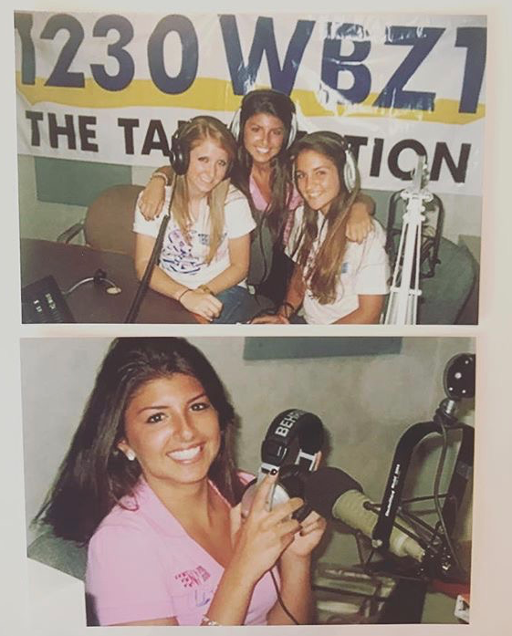
TEEN TALK LIVE
A Show To
Empower & Inspire
Our Voice
Our Opinion
Our Time To Talk…
Year: 2008

Slide 3
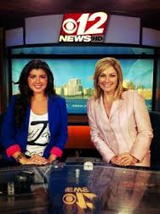
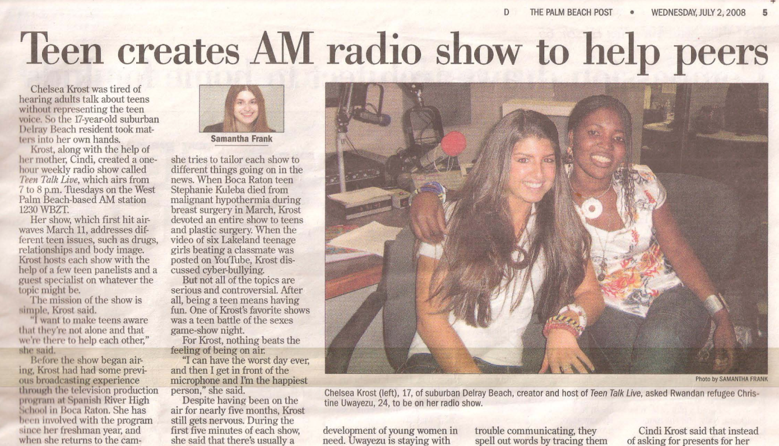
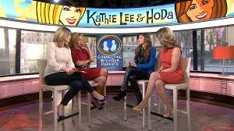
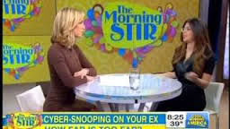
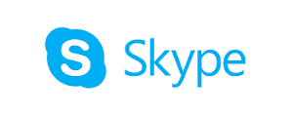
Millennial. Millennial. Millennial.

Slide 4
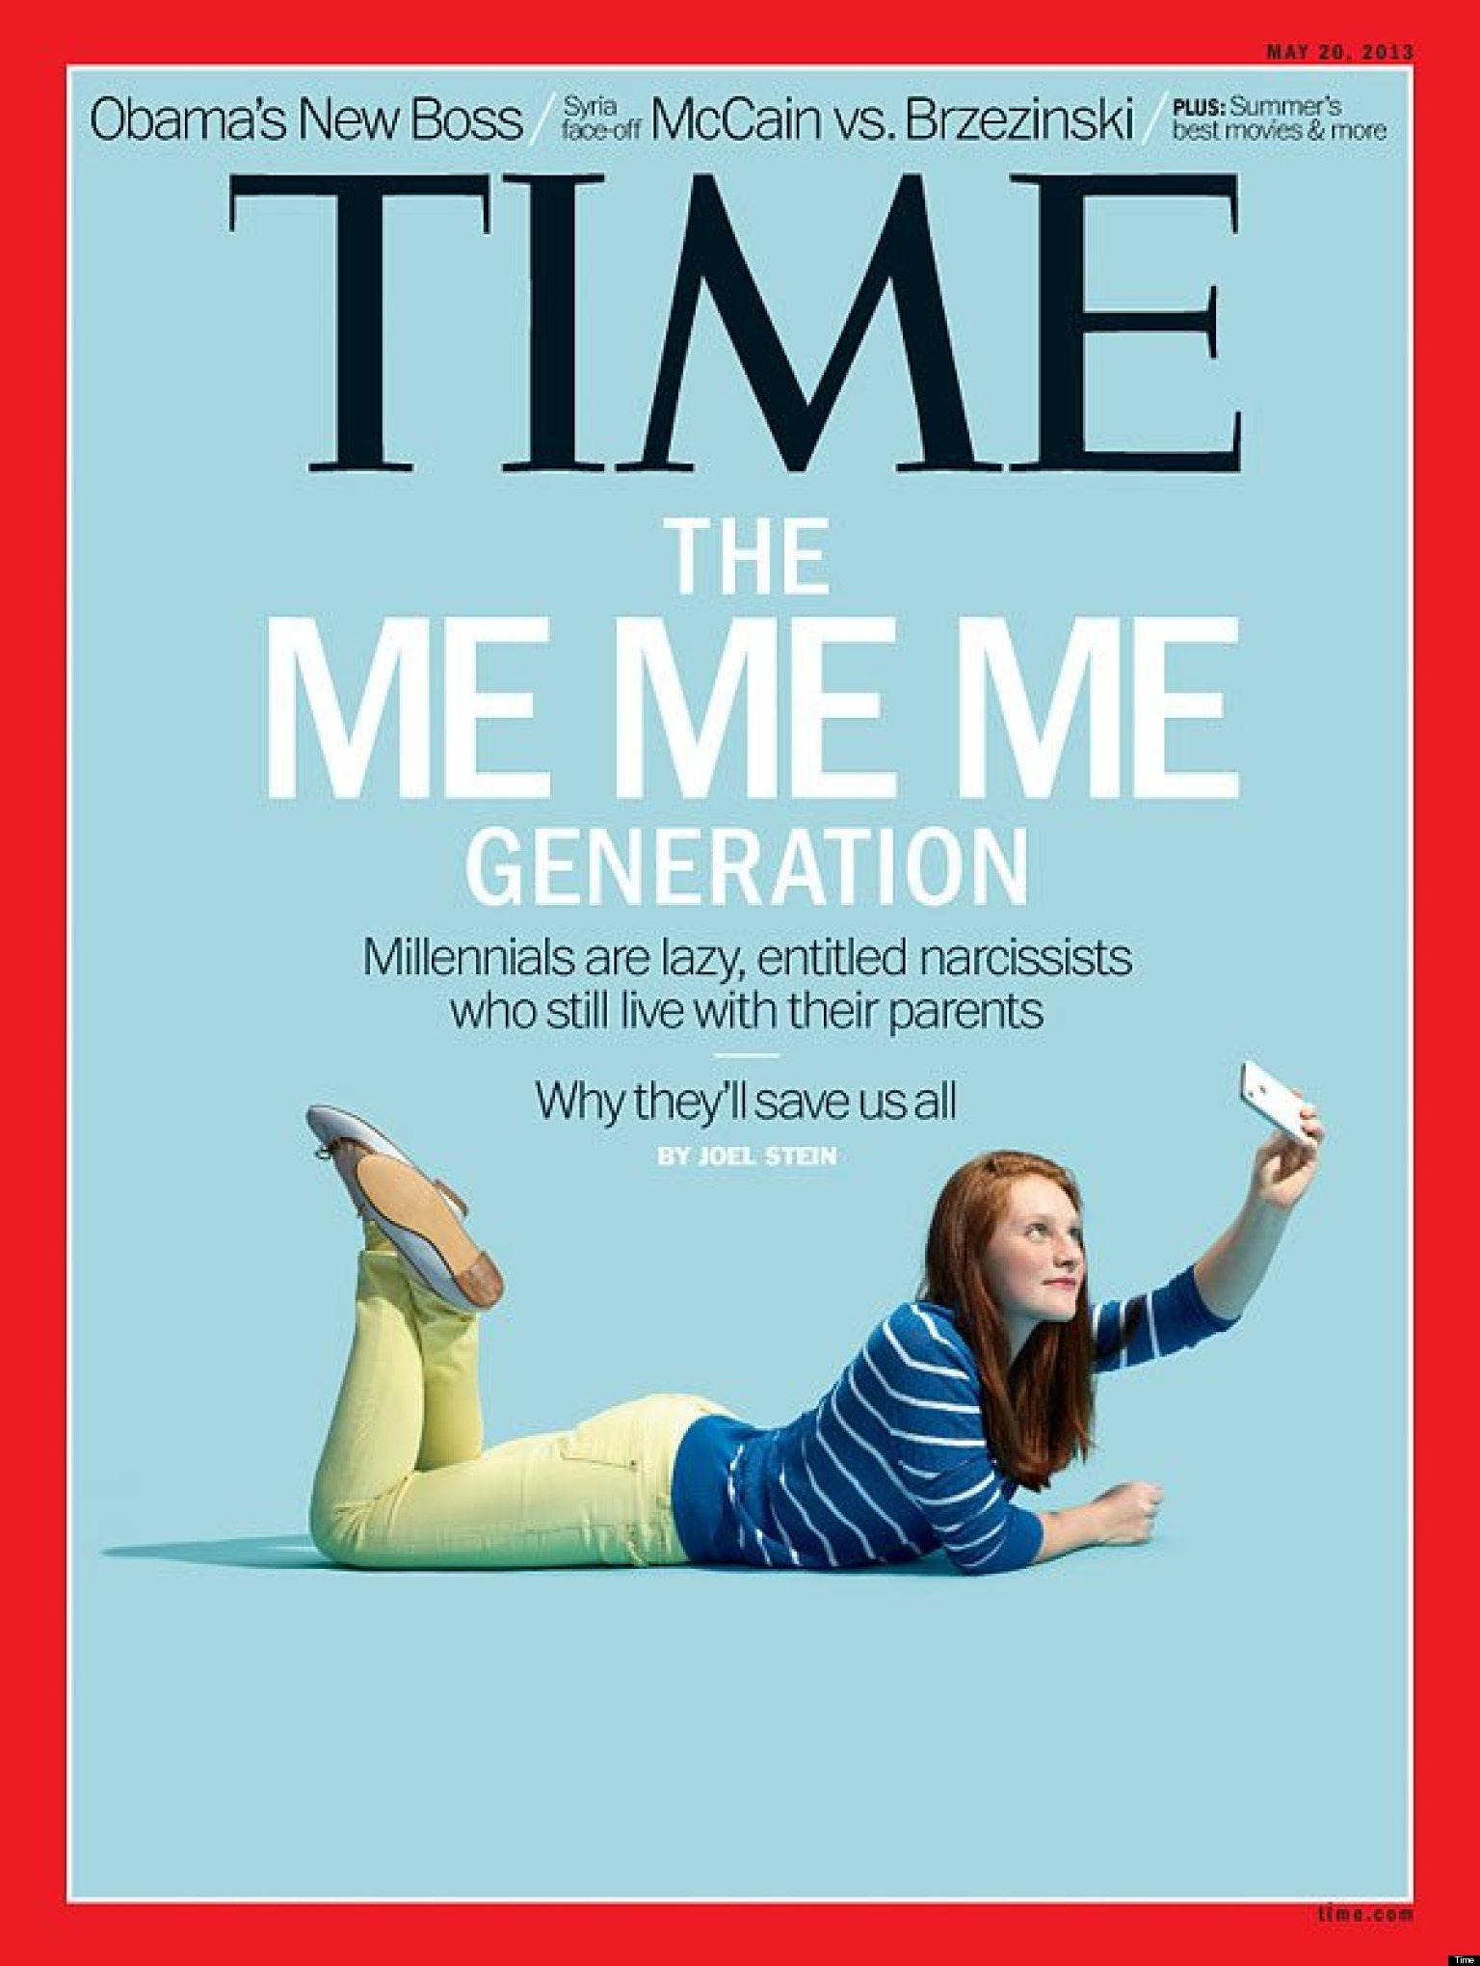
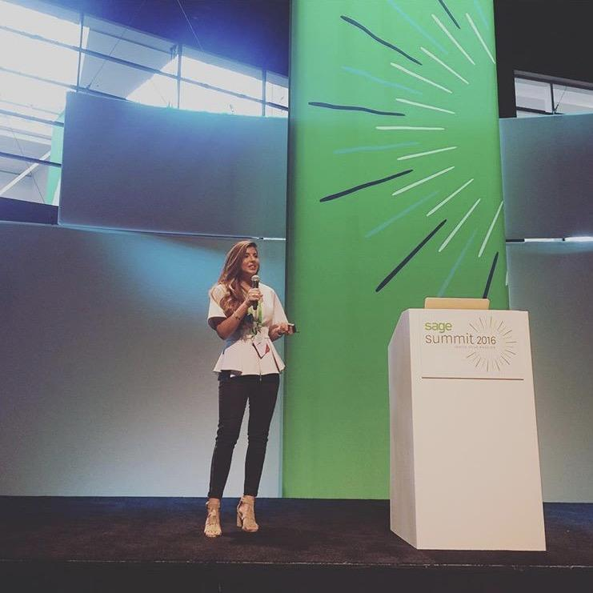
Be The Bridge
You Want To See
$200 Billion Annual Spending Power

Slide 5
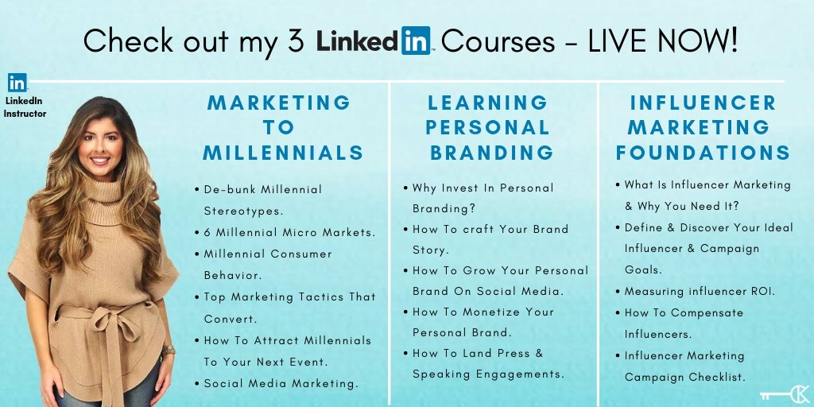

Slide 6
Who Are Millennials
Millennials
Born 1981-1996
(22-37 years old)

Slide 7
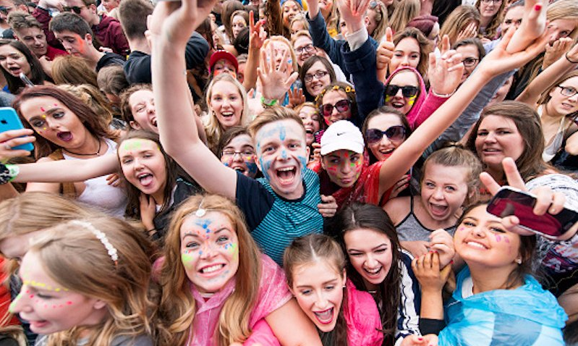
Who Are Millennials
80 million plus U.S.
Millennials
Notes:
different

Slide 8
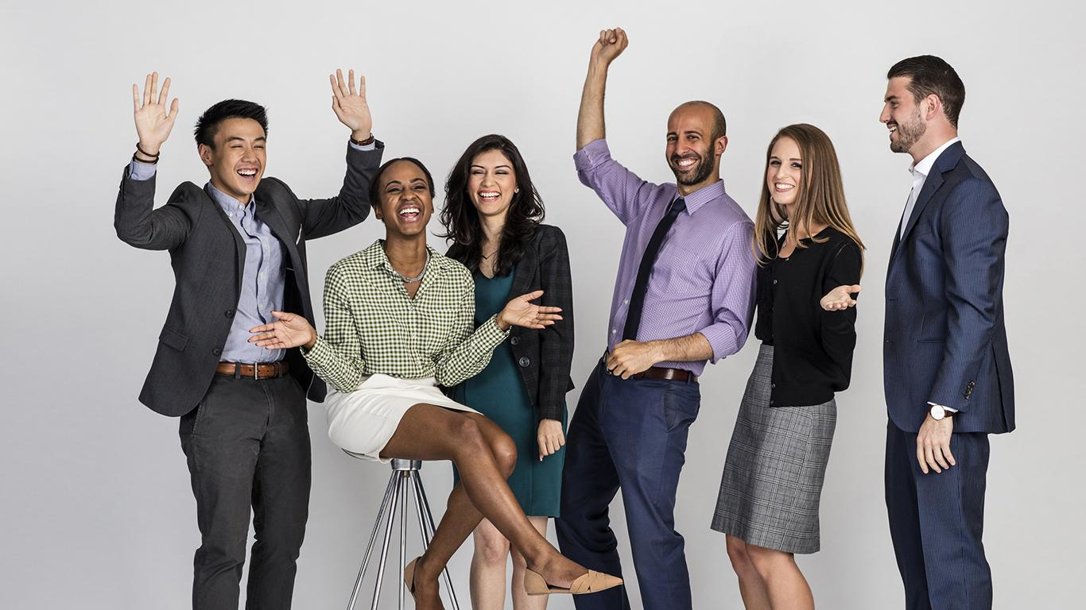
Who Are Millennials
Make up about 75% of the
U.S. workforce by 2025

Slide 9
Who Are Millennials
Most ethnically & racially diverse generation

Slide 10
Who Are Millennials
Millennials will become the biggest spenders in
Food & Beverage within
the next 10 years
CBRE Report
Notes:
a CBRE report Food in Demand: Consumers predicts.

Slide 12
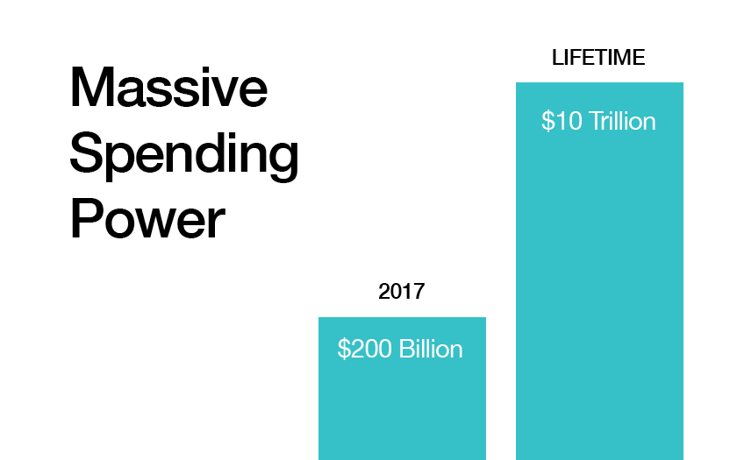
Millennial Consumer Spending Power
Notes:
New graphic

Slide 13
HOWEVER...
About 70% of grads leave college with student debt.
17 million student loan borrowers under the age of 30 in the U.S. (Federal Reserve)
Notes:
https://www.cnbc.com/2017/06/14/heres-how-much-the-average-american-in-their-20s-has-in-student-debt.html

Slide 14
Savvy Digital Shoppers
80%
of millennials use their phones to research prices before making a purchase
Notes:
https://adespresso.com/blog/marketing-to-millennials/

Slide 15
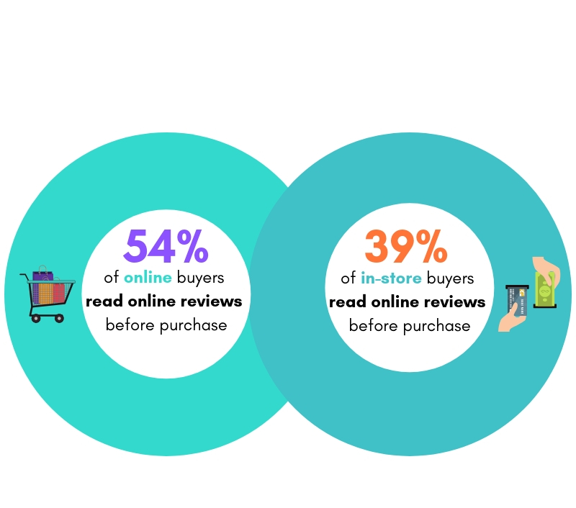
The Rise of ROPO
Research Online - Purchase Offline
Data via Bazaarvoice
Notes:
https://www.wordstream.com/blog/ws/2018/01/10/ecommerce-trends

Slide 16
In order to… CONVERT DIGITAL NATIVES TO CUSTOMERS
Notes:
Font

Slide 17
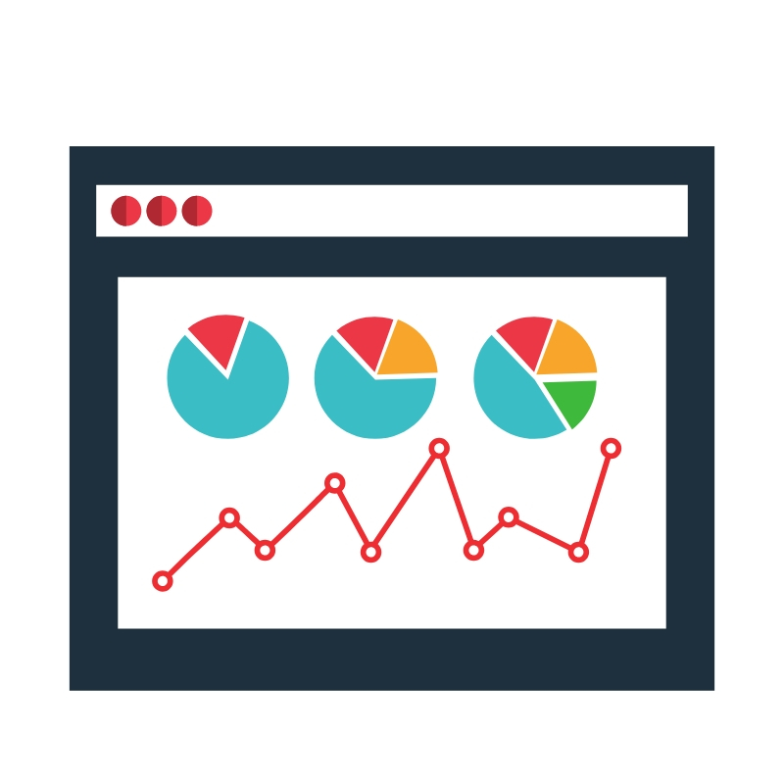
Be The Solution!
Identify Target Consumer Market
Evaluate: Demographics, Values, Needs, Pain Points
Personalize Messaging
Story tell
Be Where Your Audience Is

Slide 18
Millennial Consumer Behavior Driving Demand
Companies like Walmart are entering the market with their own private labels.
priced to lure in bargain hunters, but still drink like a $30 or $40 bottle, similar to Trader Joe's Charles Shaw line.
Notes:
Meeting consumer needs

Slide 19
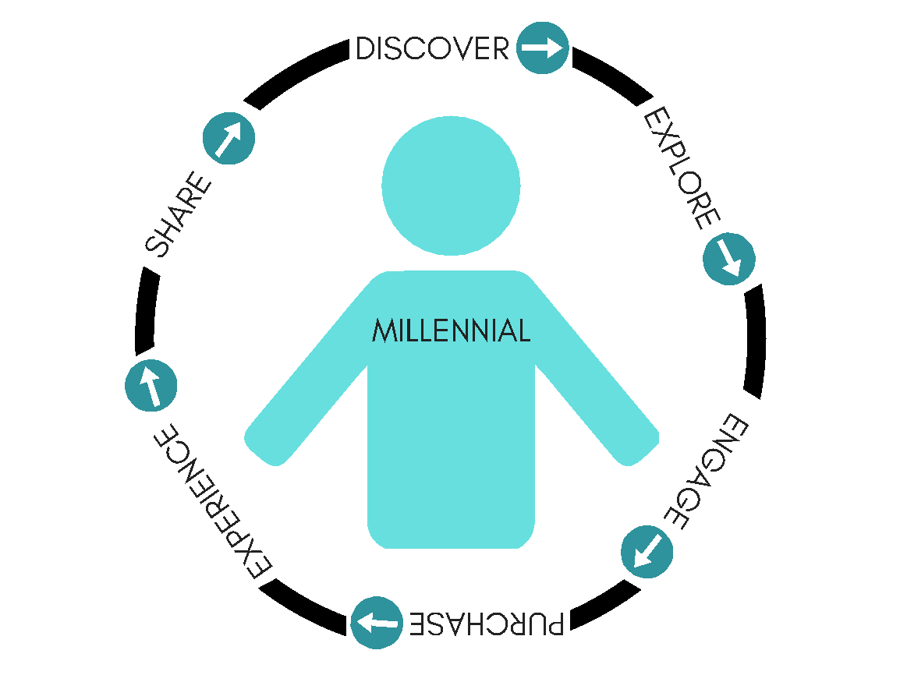
Craft Your Consumer Journey Map
Notes:
Font

Slide 20
You can not blanket market to Millennials…
Identify who your client is & where they are online…

Slide 21
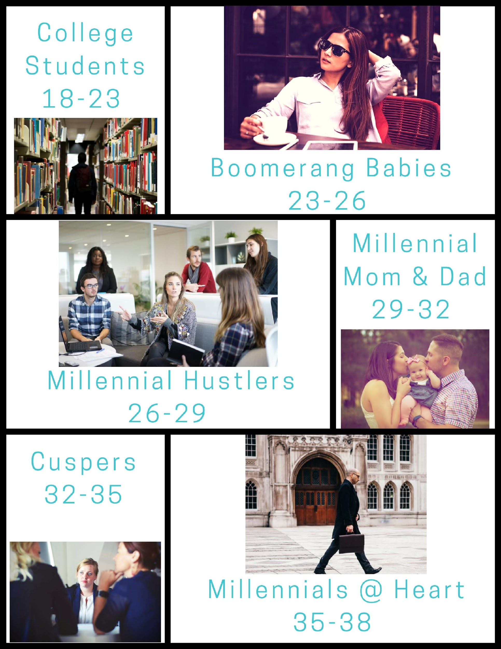
6 Millennial Micro Markets
Notes:
Create audience examples: College Student Dress for formals, Greek life, Internships : Boomerang babies: Job interviews, weddings, first date.

Slide 22
6 Millennial Micro Markets
Audience Segmentation
Gen Z - Millennial
College Students (18-23)
Student
Intern
Festival Goer
Hyper-Connected
Median Income $16,000-$22,000
Notes:
Create audience examples: College Student Dress for formals, Greek life, Internships : Boomerang babies: Job interviews, weddings, first date.

Slide 23
6 Millennial Micro Markets
Audience Segmentation
Boomerang Babies (23-26)
Entry Level Employee
Craving Experience
Boomerang Back Home – Debt
Active in Gig-Sharing Economy
Median Income $24,000-$27,000
Notes:
Create audience examples: College Student Dress for formals, Greek life, Internships : Boomerang babies: Job interviews, weddings, first date.

Slide 24
6 Millennial Micro Markets
Audience Segmentation
Millennial Hustlers (26-29)
Serious Multi-Taskers
Transitioning from Corporate to Entrepreneurship
Getting Married & Attending Wedding Festivities
Crave Customization
Median Income $38,000-$40,000
Notes:
Create audience examples: College Student Dress for formals, Greek life, Internships : Boomerang babies: Job interviews, weddings, first date.

Slide 25
6 Millennial Micro Markets
Audience Segmentation
Millennial Mom & Dad (29-32)
Mommy Blogger Boom (1 in 5)
Decision Influencers
Justify Price Point By Quality & Convenience
Median Income $40,000-$45,000
Notes:
Create audience examples: College Student Dress for formals, Greek life, Internships : Boomerang babies: Job interviews, weddings, first date.

Slide 26
6 Millennial Micro Markets
Audience Segmentation
Cusper's (32-35)
Bigger Leadership Role – More Responsibilities
Could Associate Gen X
Craving ME TIME!
Spike In Homeownership
Median Income $50,000-$55,000
Notes:
Create audience examples: College Student Dress for formals, Greek life, Internships : Boomerang babies: Job interviews, weddings, first date.

Slide 27
6 Millennial Micro Markets
Audience Segmentation
Millennial - Gen X
Millennials @ Heart (35-38)
C-level
Wants to Stay On Trend
Tech Savvy
Values Quality Products
$Median Income $55,000-$57,000
Notes:
Create audience examples: College Student Dress for formals, Greek life, Internships : Boomerang babies: Job interviews, weddings, first date. https://dqydj.com/income-percentile-by-age-calculator/

Slide 28
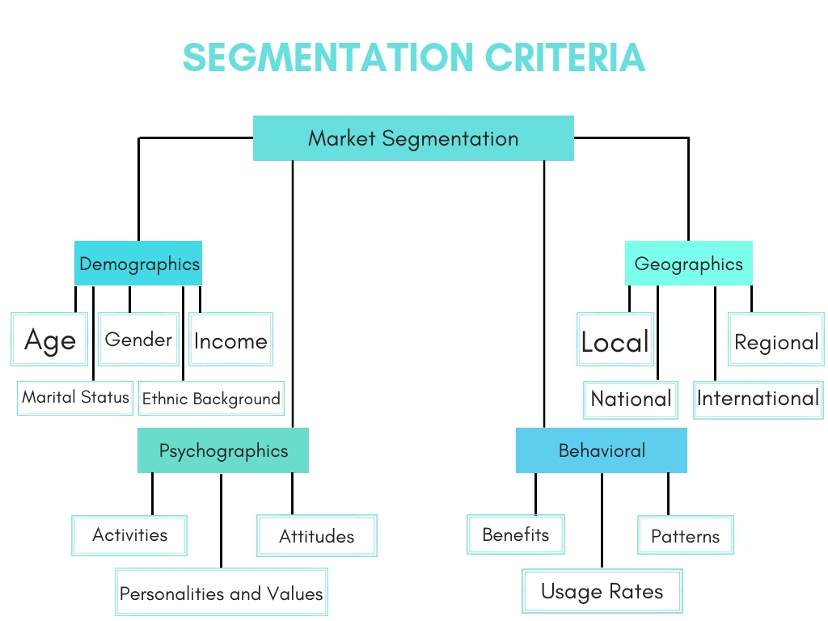
Personalize Your Marketing Messages
Notes:
CAN WE MAKE THE SMALLEST BOXES BIGGER/BIGGER FONT
http://www.b2bmarketingexperiences.com/2017/04/successful-personalized-marketing/
http://www.targetmarketingmag.com/post/5-effective-audience-segments-for-digital-marketing/
Likelihood of buying: When your marketing messages are relevant to the situation of customers and their interests, they are more likely to buy.
Increasing customer lifetime value: Focusing on increasing the lifetime value of each customer as much as possible by making your marketing contextual is a key driver of long-term profitability.
Better insight into customer base: Examining the performance of certain customer segments provides important insight into the health of your customer base, enables you to spot trends and patterns in what’s working and what isn’t, and can help inform your strategy going forwards.

Slide 29
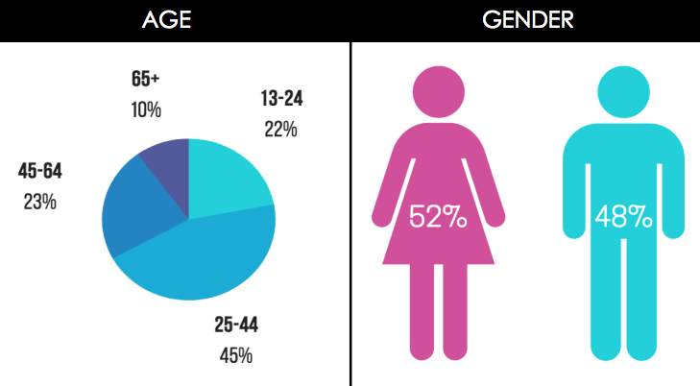
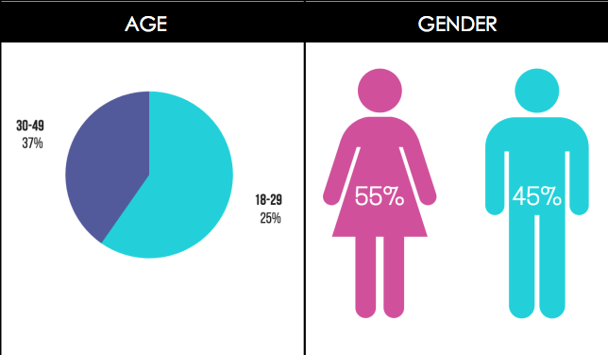
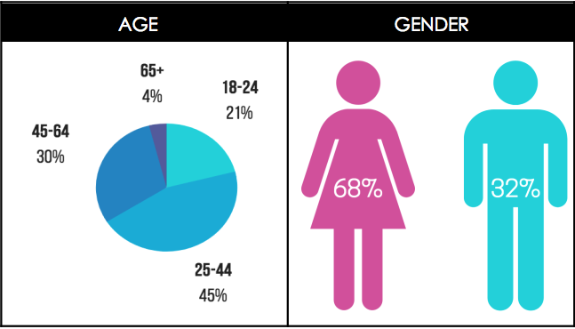
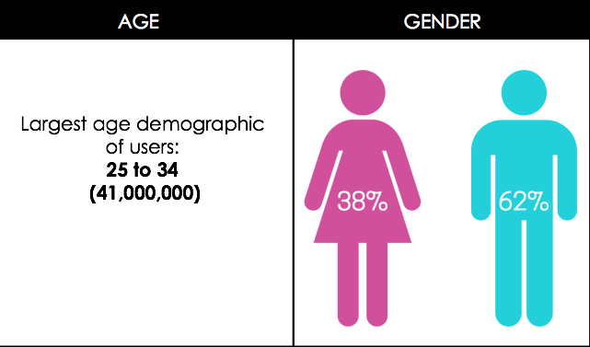
Where Is Your Target Client?
Notes:
Speak to your target audience – more chance of sales
Scale followers
SOCIAL DEMO BONUS
Scale enagement
Scale influence
Brand Ambassador Community
SAVE YOURSELF TIME & MONEY

Slide 30
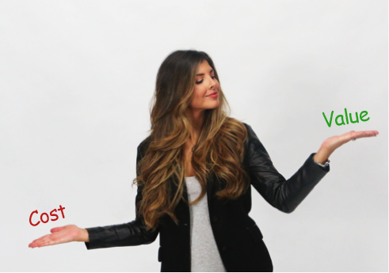
Know What Your Customers Value

Slide 31
Millennial Seek Health Conscious Alternatives
Younger consumers are more health conscious than previous generations
Millennials are ordering more spirits vs beer because of the reduction in calories.
60% of millennials often opt for a lower calorie drink.
Notes:
https://www.restaurantdive.com/news/millennials-to-be-the-biggest-food-and-beverage-spenders-in-10-years/552877/
https://www.breakthrubev.com/news/2018-millennial-trends
https://www.huffingtonpost.ca/timi-gustafson/younger-consumers-are-mor_b_14290774.html

Slide 32
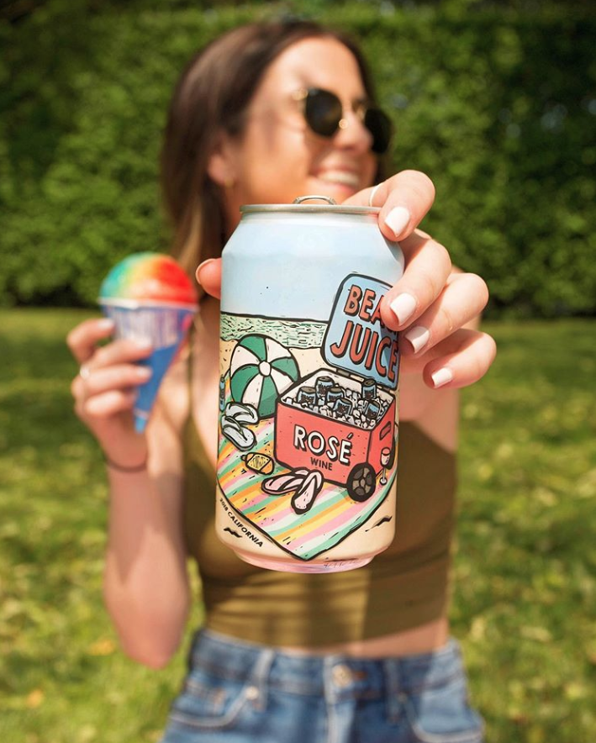
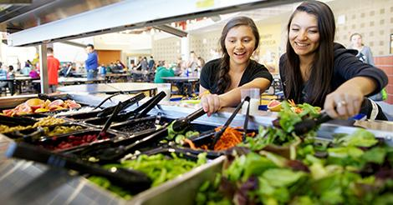
Know What Your Customers Value
Quality. Customization. Instant Gratification.
Notes:
Millennials have been particularly conscious with their spending, given their growing student debt and lack of assets, which has driven up demand for low-priced food options such as fast casual and fast food.

Slide 33
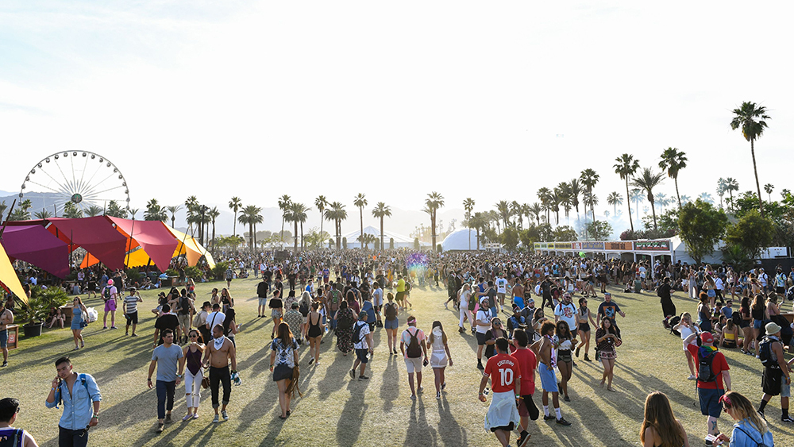
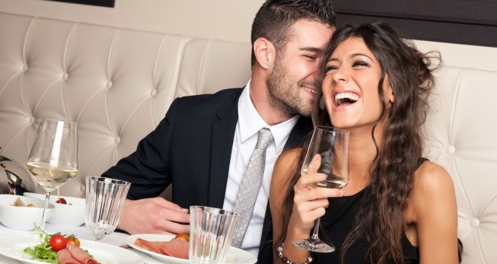
Know What Your Customers Value
Experience!

Slide 34
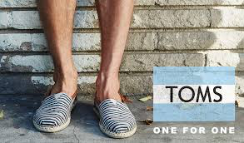
Know What Your Customers Value
Authenticity. Transparency.
Social Good Component. Sustainable.

Slide 35
THINK LESS TRADITIONAL
& MORE TRA-DIGITAL
Notes:
make font nice

Slide 36
Marketing Tactics: In & Out
Tra-Digital
Mobile Optimized…………………..Not Thinking Mobile First
Traditional
Notes:
MOBILE
80% of shoppers used a mobile phone inside of a physical store to compare pricing & read reviews. (Outerbox)
Consumers are spending 15+ hours/week researching on their smartphones (Google)
95% of users look up local information on mobile to call or find business location. (Invesp)
56% of mobile users intend to use their device to search/buy gifts for holiday season, 2017. (Invesp)

Slide 37
Gone Mobile...
On average, Google gets about 50 billion mobile searches a month.
In 2019, mobile phones will surpass TV attracting the most minutes of attention in the US.
Notes:
https://www.pixelunion.net/blog/mobile-ecommerce-stats/
add visual

Slide 38
Marketing Tactics: In & Out
Content Marketing Strategy…………………..No Consistency
Tra-Digital
Traditional
Notes:
MOBILE
Consumers are spending 15+ hours/week researching on their smartphones (Google)
80% of shoppers used a mobile phone inside of a physical store to compare pricing & read reviews. (Outerbox)95% of users look up local information on mobile to call or find business location. (Invesp)
56% of mobile users intend to use their device to search/buy gifts for holiday season, 2017. (Invesp)

Slide 39
Marketing Tactics: In & Out
Brand Blog or Podcast......................No Traffic Generator
Tra-Digital
Traditional
Notes:
MOBILE
80% of shoppers used a mobile phone inside of a physical store to compare pricing & read reviews. (Outerbox)
Consumers are spending 15+ hours/week researching on their smartphones (Google)
95% of users look up local information on mobile to call or find business location. (Invesp)
56% of mobile users intend to use their device to search/buy gifts for holiday season, 2017. (Invesp)

Slide 40
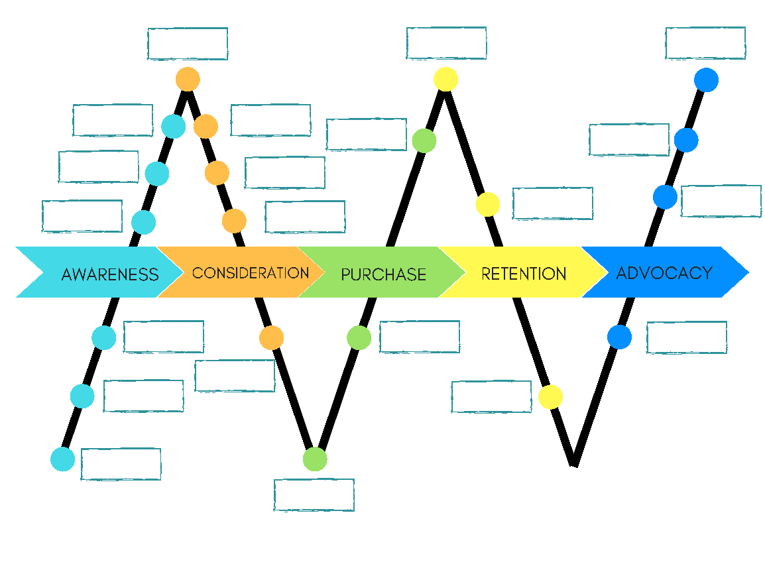
Content Fuels the
Consumer Journey

Slide 41
Blogs, Vlogs, & Social Media - OH MY!
Nearly 60% of Millennials have turned to a blog or social media post to validate purchase.
47% of buyers viewed 3-5 pieces of content before engaging with a sales rep.
53% of marketers say blogging is their top content marketing priority.
Notes:
https://www.impactbnd.com/blog/blogging-statistics-to-boost-your-strategy

Slide 42
Marketing Tactics: In & Out
Tra-Digital
Micro Video Content………………..Long Form Article Content
Traditional
Notes:
MOBILE
80% of shoppers used a mobile phone inside of a physical store to compare pricing & read reviews. (Outerbox)
Consumers are spending 15+ hours/week researching on their smartphones (Google)
95% of users look up local information on mobile to call or find business location. (Invesp)
56% of mobile users intend to use their device to search/buy gifts for holiday season, 2017. (Invesp)

Slide 43
Think Micro Moments

Slide 44
Video Stats
Video marketing accounts for 69% of all consumer traffic.
96% of shoppers find videos helpful when making purchase decisions online.
51% of marketing professionals worldwide name video as the type of content with the best ROI.
Notes:
https://ppcprotect.com/video-marketing-statistics/

Slide 45
Video Helps Boost Traffic & Retention
The average user spends 88% more time on a website with video.
Viewers retain 95% of a message when they watch it in a video compared to 10% when reading text?
Notes:
https://www.forbes.com/sites/tjmccue/2018/06/22/video-marketing-2018-trends-continues-to-explode-as-the-way-to-reach-customers/#450411c5598d

Slide 46
Marketing Tactics: In & Out
Tra-Digital
Social Strategy………………… Social Silence
Traditional
Notes:
MOBILE
80% of shoppers used a mobile phone inside of a physical store to compare pricing & read reviews. (Outerbox)
Consumers are spending 15+ hours/week researching on their smartphones (Google)
95% of users look up local information on mobile to call or find business location. (Invesp)
56% of mobile users intend to use their device to search/buy gifts for holiday season, 2017. (Invesp)

Slide 47
6 Keys To Social Media Success
Have a defined audience
Personalize your messaging
Consistent content
Don’t sell - story tell
Engage the audience
Use for fast customer service

Slide 48
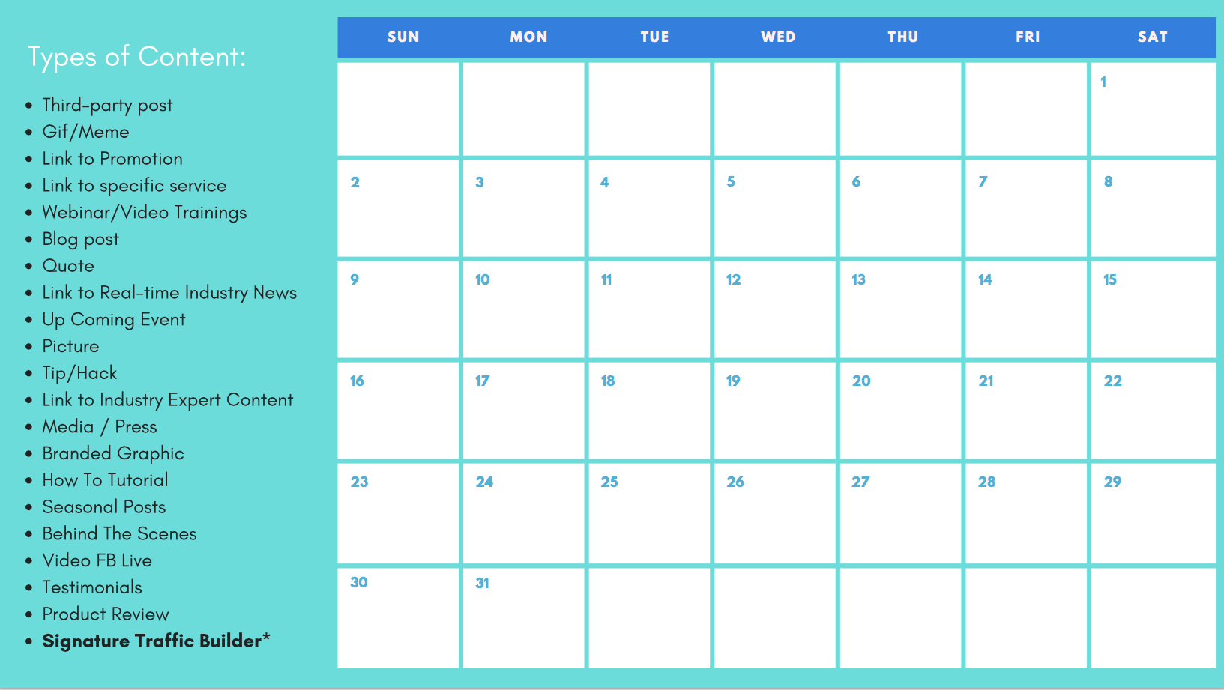

Slide 49
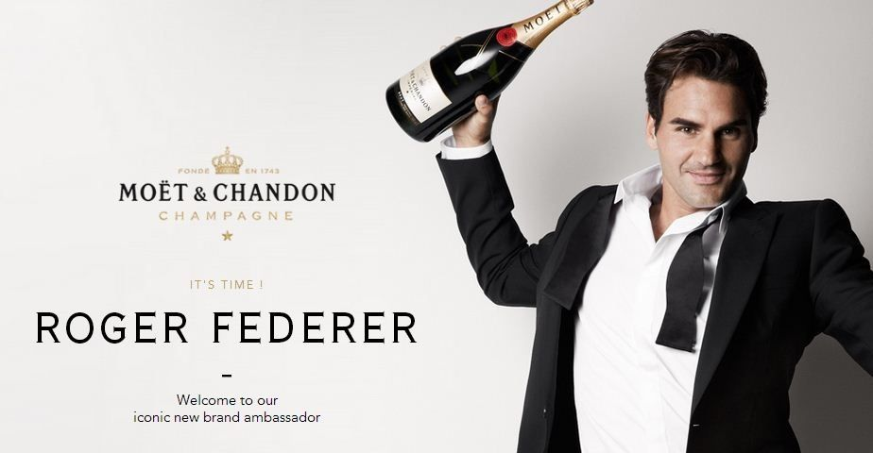
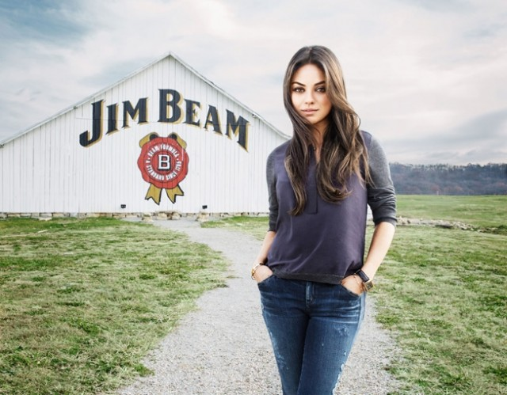
Marketing Tactics: In & Out
Tra-Digital
Influencer Marketing……………….No Peer To Peer Impact
Traditional
Notes:
MOBILE
80% of shoppers used a mobile phone inside of a physical store to compare pricing & read reviews. (Outerbox)
Consumers are spending 15+ hours/week researching on their smartphones (Google)
95% of users look up local information on mobile to call or find business location. (Invesp)
56% of mobile users intend to use their device to search/buy gifts for holiday season, 2017. (Invesp)

Slide 50
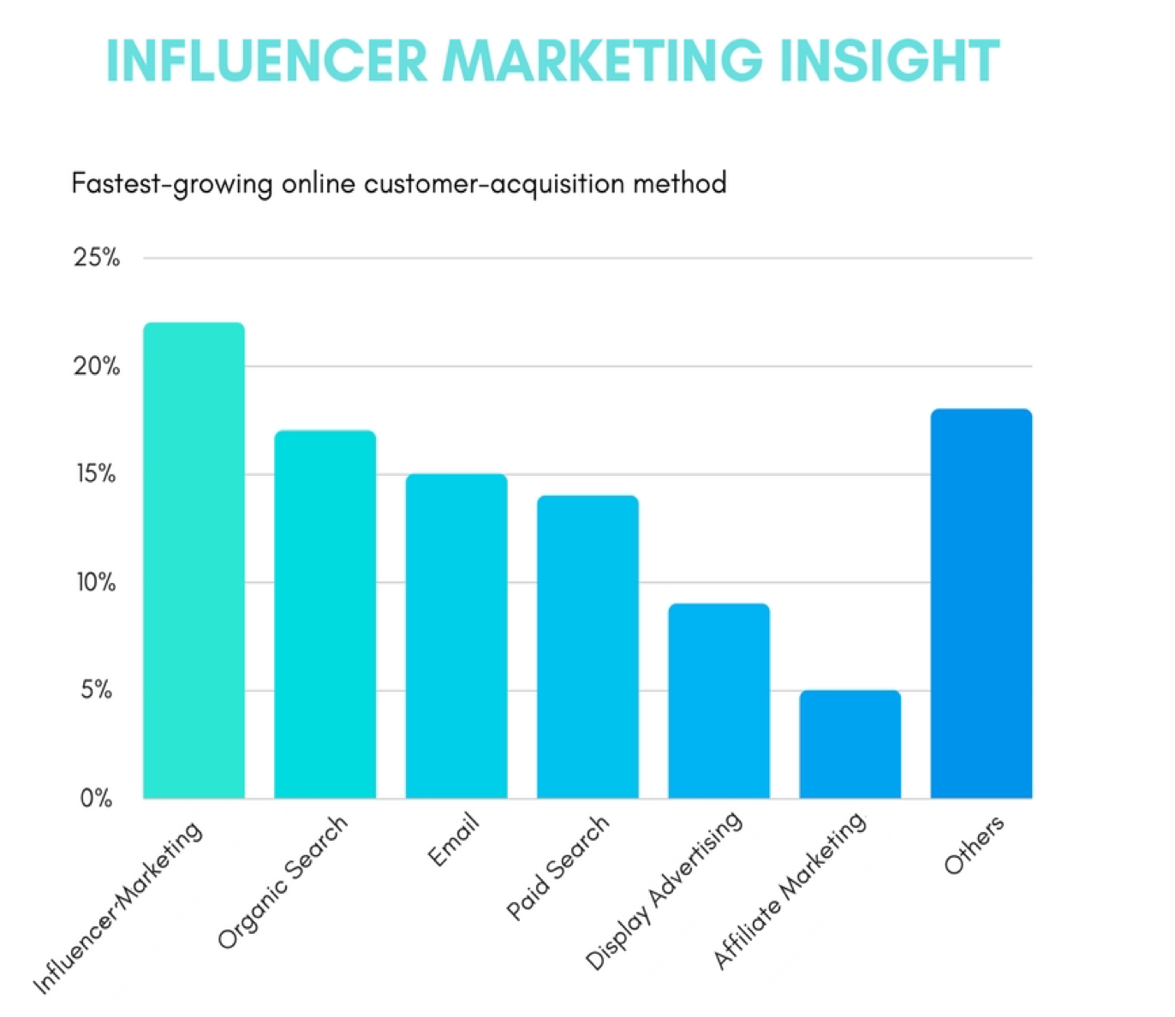
Fastest Growing Online Acquisition Method
Notes:
94% of marketers who use influencer marketing find it an effective practice, and influencer marketing can generate up to 11x the ROI of traditional advertising.
https://www.socialmediatoday.com/news/the-influencer-marketing-revolution-infographic/517146/

Slide 51
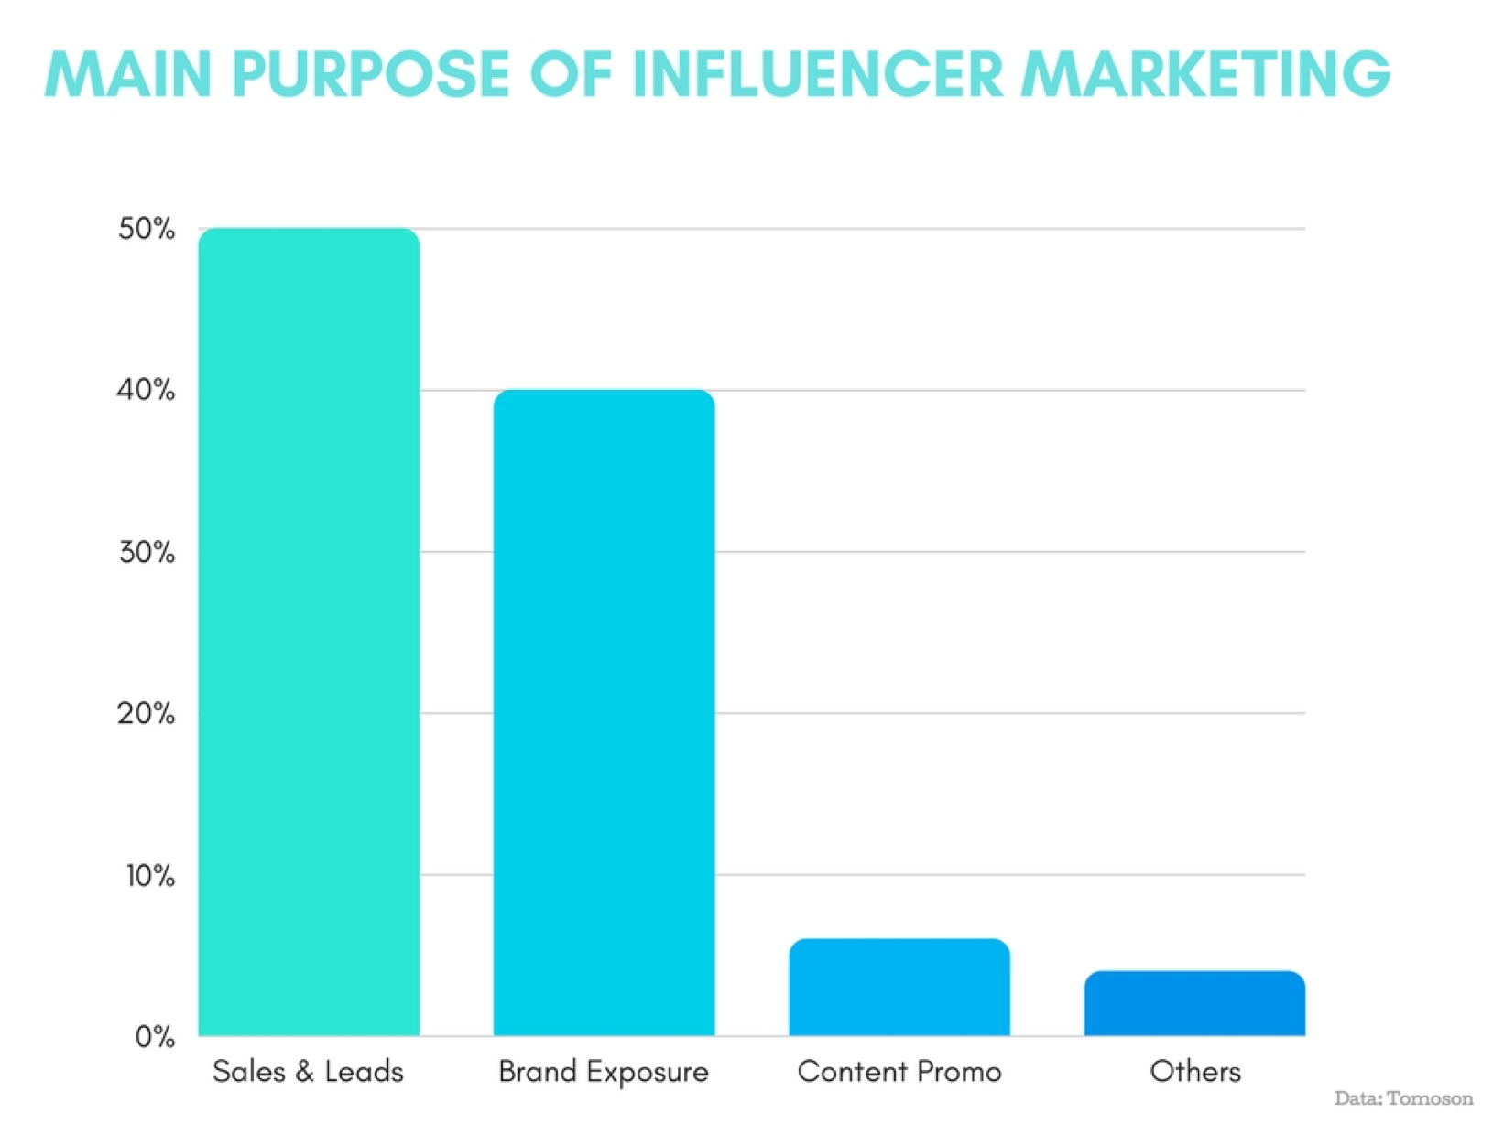

Slide 52
The Proof Is In the ROI
94% of marketers said influencer marketing is an effective practice
&
can generate up to 11x the ROI of traditional advertising.
Notes:
https://www.socialmediatoday.com/news/the-brand-value-of-influencer-marketing-in-2018-infographic/520810/

Slide 53
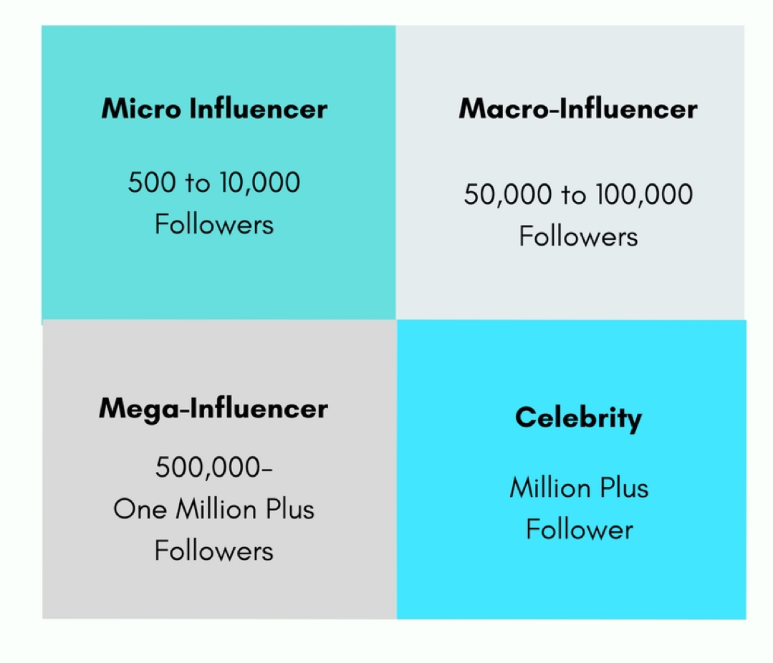
Micro Blogger Communities
Create a Big Impact
Notes:
https://www.socialmediatoday.com/news/the-brand-value-of-influencer-marketing-in-2018-infographic/520810/

Slide 54
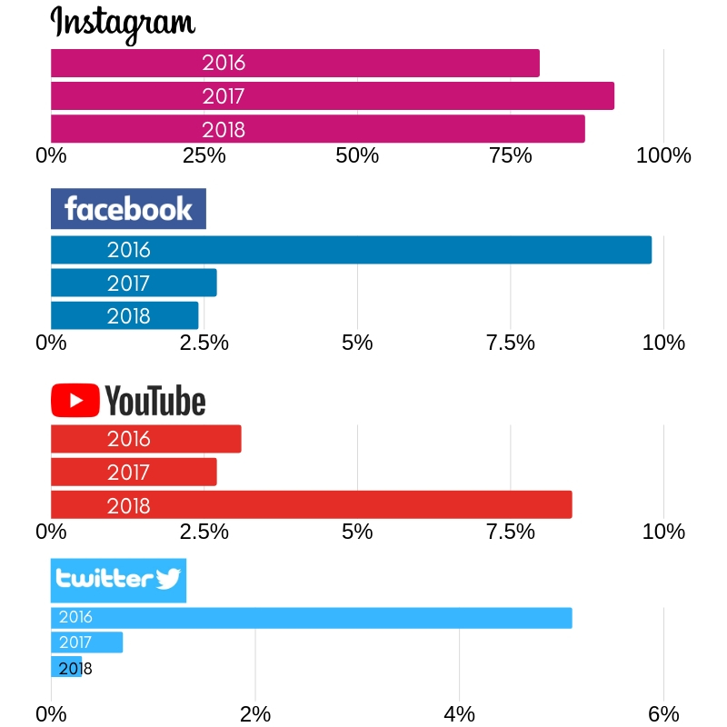
92%
of marketers say Instagram is the most important social platform for influencer marketing.
Notes:
https://influencermarketinghub.com/9-mind-blowing-influencer-marketing-statistics/

Slide 55
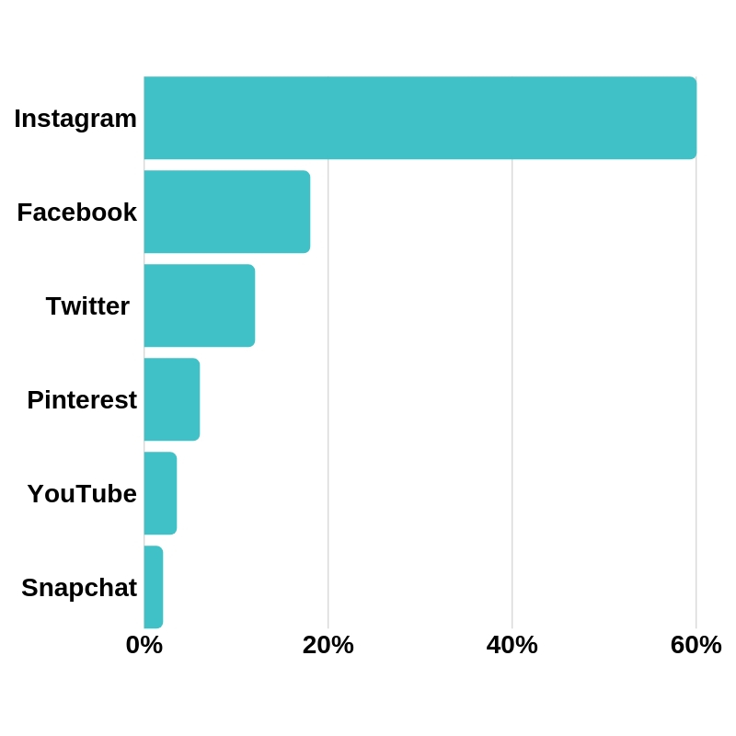
Which platfom is the most effective for engaging your target audience?
87%
of influencers chose Instagram as their #1 platform in 2018
Notes:
https://influencermarketinghub.com/9-mind-blowing-influencer-marketing-statistics/

Slide 56
Marketing Tactics: In & Out
Tra-Digital
User Generated Content …………..Traditional Advertising
Traditional
Notes:
MOBILE
80% of shoppers used a mobile phone inside of a physical store to compare pricing & read reviews. (Outerbox)
Consumers are spending 15+ hours/week researching on their smartphones (Google)
95% of users look up local information on mobile to call or find business location. (Invesp)
56% of mobile users intend to use their device to search/buy gifts for holiday season, 2017. (Invesp)

Slide 57
UGC Does Influence Purchasing Decisions
93% of consumers find UGC to be helpful when making a purchasing decision.
On-site consumer reviews can increase conversions by 74%.
Notes:
https://www.tintup.com/blog/38-mind-blowing-stats-effectiveness-user-generated-content/

Slide 58
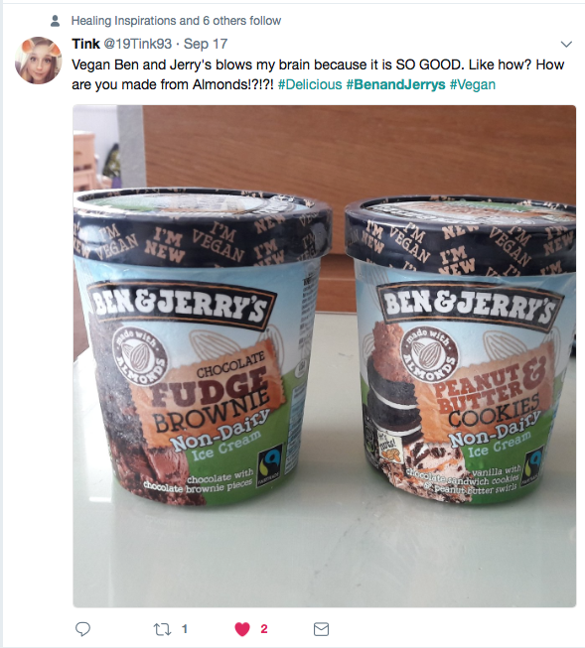
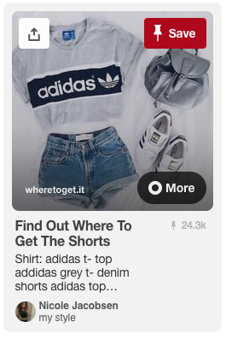
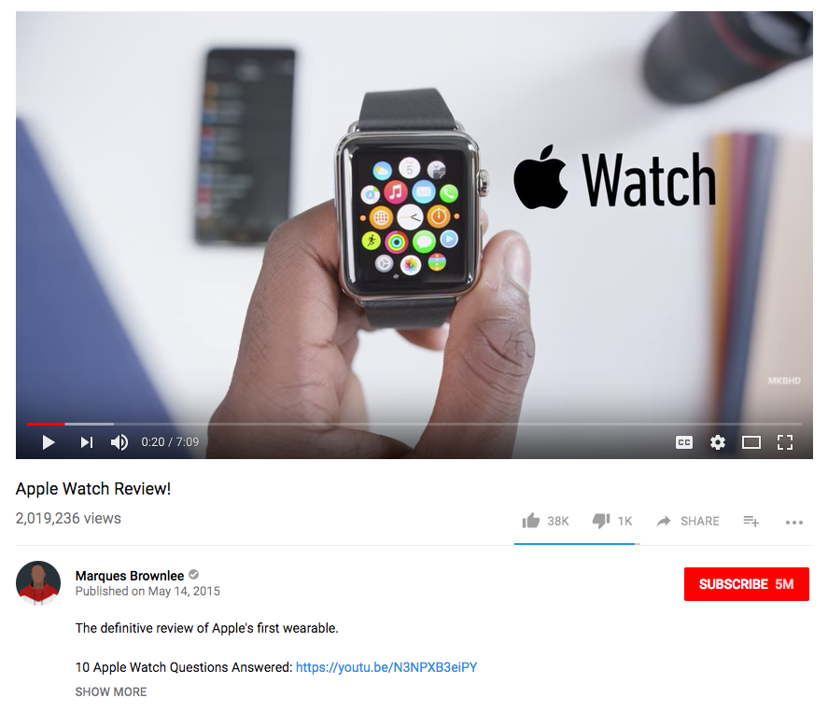
UGC videos on YouTube get
10x more views
than content created & uploaded brand
Notes:
50% Of millennials have said UGC has influenced their purchasing decisions
90% Of consumers trust online content from friends and family above all other forms of brand messaging

Slide 59
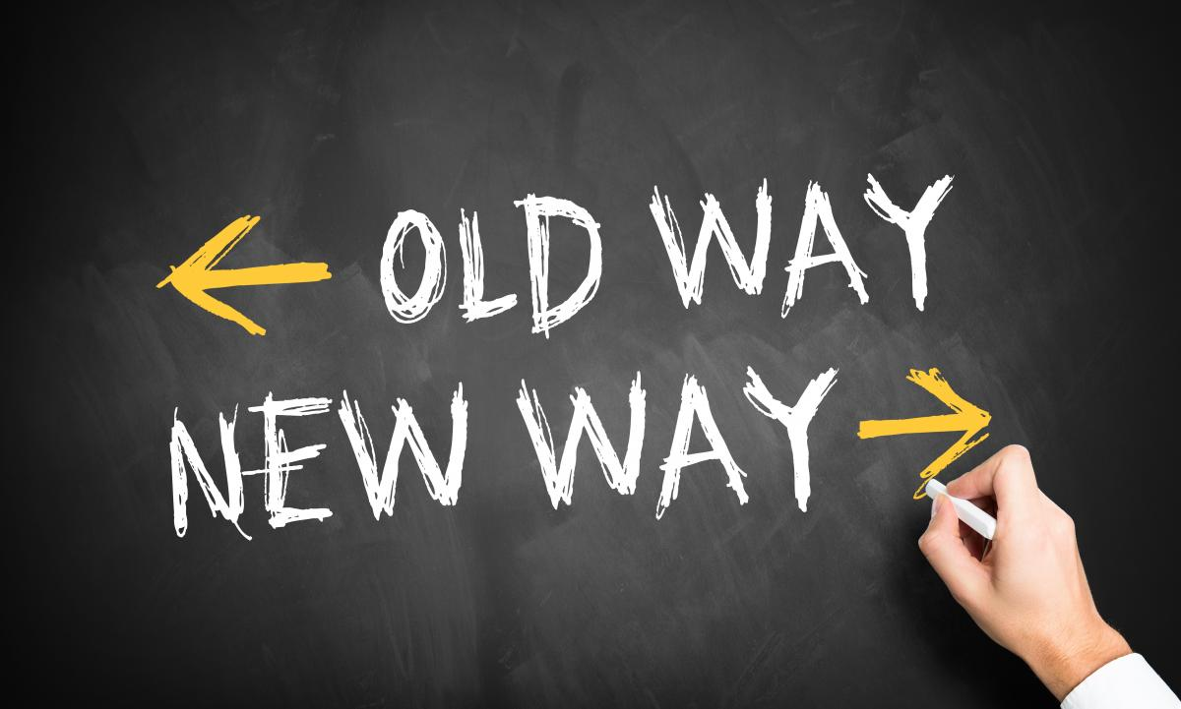
To Market
To Work

Slide 60
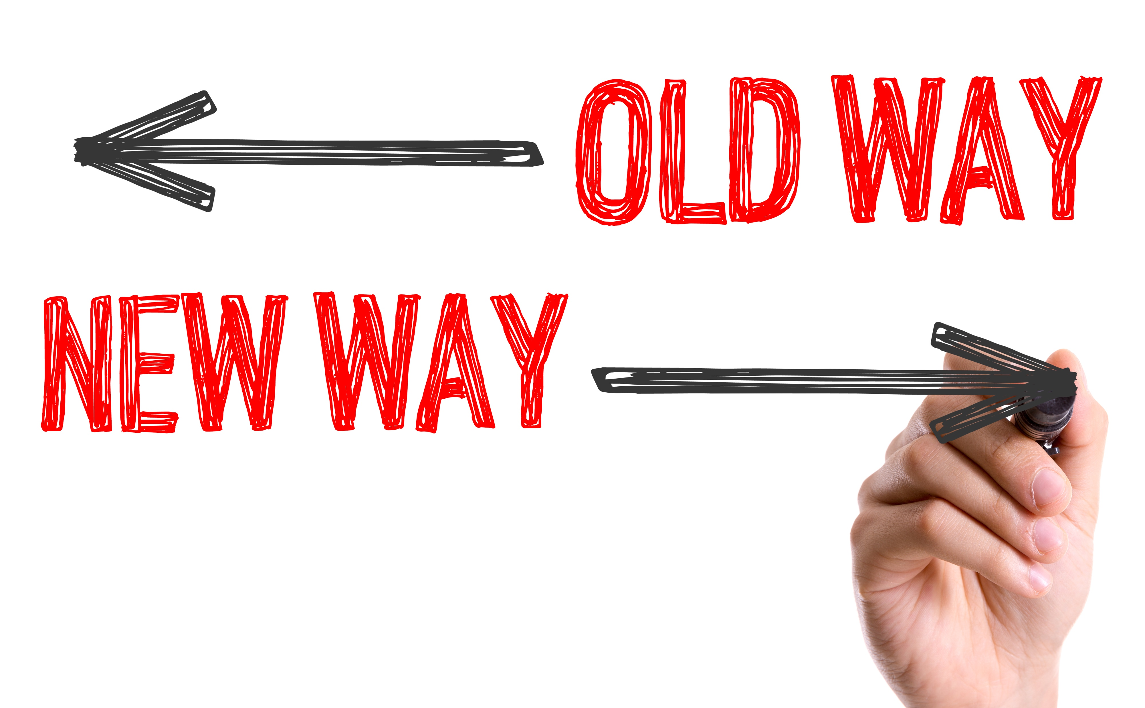
Today’s Workplace Reality
4 Generations Under One Roof
Millennials Have Pioneered A Shift - New Way To Work
Notes:
It depends. Most decisions come down to values and priorities, right? Well, then, what does the organization value more; input (equal effort from all members of the sales team) or output (sales revenue)?
Technique #2: Focusing more on outputs generally means granting more individual freedom to achieve results rather than “micromanaging” inputs.

Slide 61
What do Millennials value in a Job?
Flexibility
Financial Freedom
Communication
Community
Purpose
Growth

Slide 62
Why Millennials Job Hop
Cost of Living – Debt Crisis
No employee advocacy or positive morale
Disengaged co workers or management - Generational Barriers*
Every person or themselves
Lack of innovation & technology
One annual review only
Little room for growth
No corporate social responsibility
79% of people who quit their jobs cite ‘lack of appreciation
Notes:
91% of Millennials expect to stay in their current job for 3 years or less, with 45% of companies reporting higher turnover rates among this group vs. other generations.
https://www.forbes.com/sites/davidsturt/2018/03/08/10-shocking-workplace-stats-you-need-to-know/#3f7e275ef3af

Slide 63
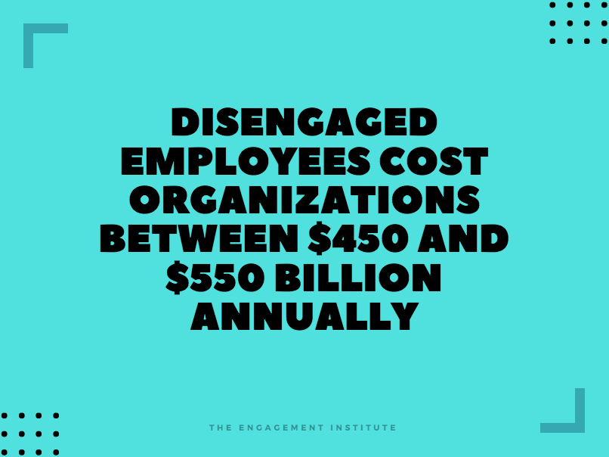

Slide 64
Not engaged employees are those who show up and do just enough to get by. Never go the extra mile. Punch in Punch out mentality.
Actively disengaged employees are actively working against the organizations they work for. These employees are toxic within the workplace and could impact employee morale and performance.

Slide 65
How To Close The Skills Gap
58% of managers said they didn’t receive any management training.
CareerBuilder
NOW it’s time for action!

Slide 66
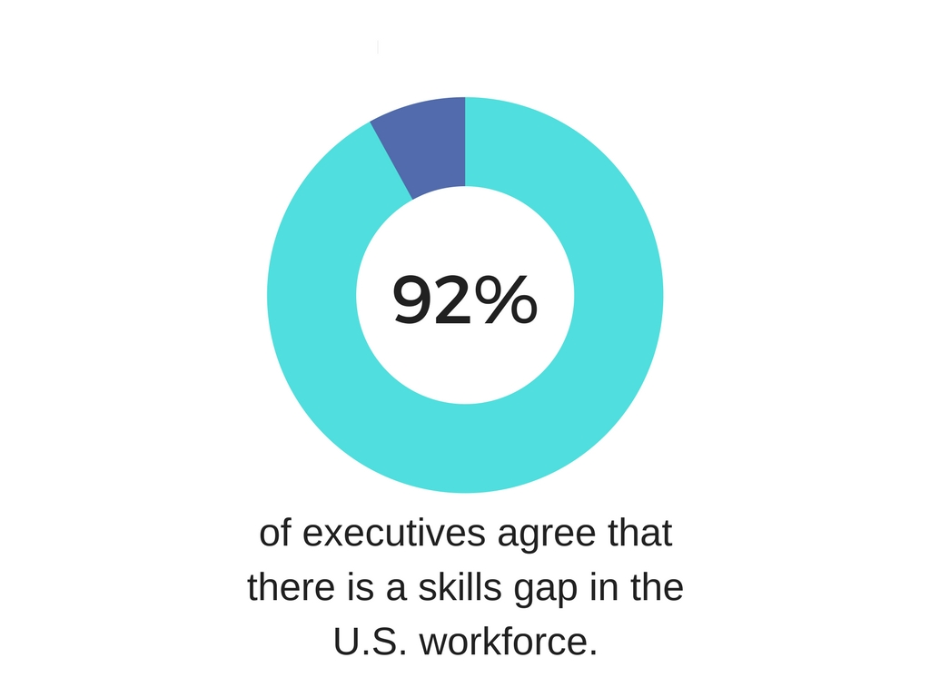
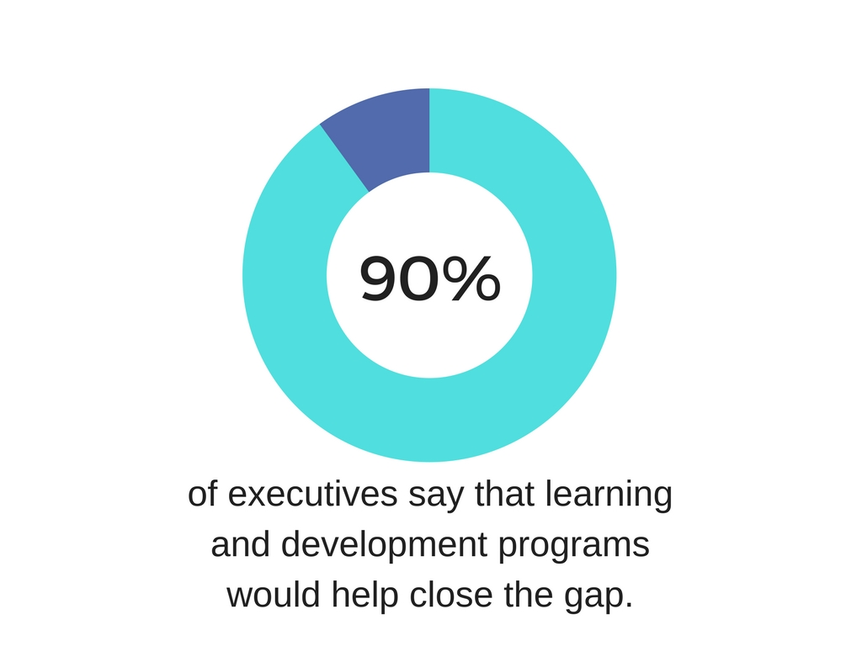
How To Close The Skills Gap

Slide 67
How To Enhance Employee Engagement
Avoid “One Size Fits All” Thinking
Acknowledge Shared Needs & Values
Reverse Mentorship Opportunities
Fuel The Entrepreneur Within & Let Them Innovate
Crowdsource Feedback & Take Action
Be Transparent About Growth Benchmarks
Get Out Of The Office & Create A Shared Experience
Notes:
Avoid “One Size Fits All” Thinking
:When you understand what motivates (or sets off) certain generational groups or individuals, you can tailor your response, build more effective teams, and adjust recognition and reward programs.
Reverse Mentorship Opportunities
Fuel The Entrepreneur Within And Let Them Innovate; entreprenurial at heart, are native creators and don’t do well with not being able to innovate or think/operate/engage outside the box
https://www.mindtickle.com/blog/10-millennial-personality-traits-hr-managers-cant-ignore

Slide 68
Employee Influence
Employee influencers & advocates are a powerful asset that can elevate your brand and can make a positive impact in your marketing success.

Slide 69
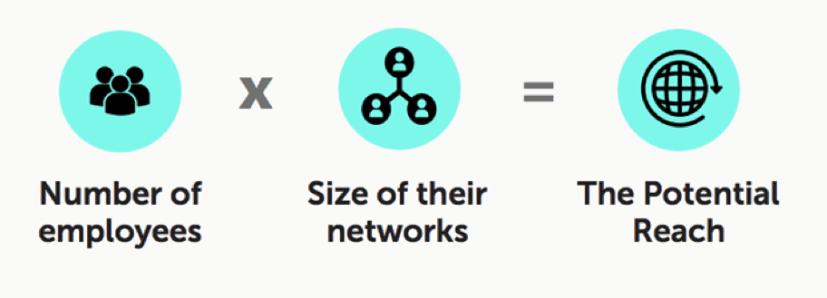
Power In Employee Advocacy
Brand messages are re-shared 24 times more frequently when distributed by employees’ vs the brand Source: MSLGroup
Leads developed through employee social marketing convert 7x more frequently than other leads Source: IBM

Slide 70
How To Leverage Your Employees As Influencers
Create an Employee Advocacy Program That Cultivates Employee Influencers
Make It Purpose Driven:
-Quality Content
-Brand Awareness
-Corporate Social Responsibility
-Personal Authority
-Team Building
Notes:
Employee advocacy is an exercise where organisations’ employees have a presence on social media, in which they push out content relating to their brand and/or their industry.
why you should focus on employee advocacy are:
Positive exposure and brand awareness
Product and brand recommendations
Representing your company’s values and culture externally, not just internally
Present your employees as experts and credible representatives/spokespeople
Employees will seem immersed within the industry

Slide 71
Employees of socially engaged companies are more likely to stay at their company, feel optimistic about their company’s future and believe their company is more competitive!

Slide 72
C
THE 6 C’S:
CONNECTION
COMMUNICATION
COLLABORATION
CREATIVTY
CROWDSOURCE
CONSISTENCY

Slide 73
BONUS
Free Course For LinkedIn Premium Users

Slide 74
Thank You!
Chelseakrost.com
@chelseakrost
#millennialtalk

Slide 75
RESOURCE LINKS
https://expandedramblings.com/index.php/youtube-statistics/
https://www.statista.com/statistics/266879/facebook-users-in-the-us-by-gender/
https://www.omnicoreagency.com/instagram-statistics/
https://www.omnicoreagency.com/twitter-statistics/
https://www.youtube.com/yt/about/press/
https://adespresso.com/blog/marketing-to-millennials/
https://www.cnbc.com/2017/06/14/heres-how-much-the-average-american-in-their-20s-has-in-student-debt.htm
https://www.impactbnd.com/blog/blogging-statistics-to-boost-your-strategy
https://www.betterteam.com/social-recruiting-tips
https://www.restaurantdive.com/news/millennials-to-be-the-biggest-food-and-beverage-spenders-in-10-years/552877/
https://www.breakthrubev.com/news/2018-millennial-trends
https://www.huffingtonpost.ca/timi-gustafson/younger-consumers-are-mor_b_14290774.html
Altimeter & LinkedIn Relationship Economics
l

